Slide 1
Hashing

Slide 2
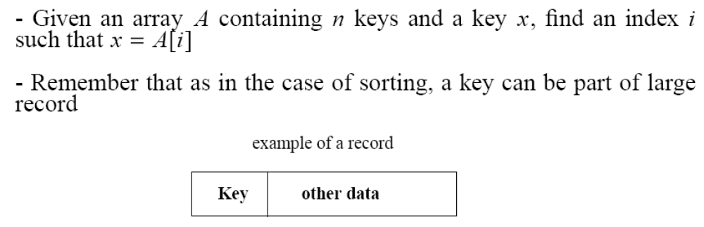
The Search Problem
Find items with keys matching a given search key
  Given an array A, containing n keys, and a search key x, find the index i such as x=A[i]
  As in the case of sorting, a key could be part of a large record.

Slide 3
Applications
Keeping track of customer account information at a bank
  Search through records to check balances and perform transactions
Keep track of reservations on flights
  Search to find empty seats, cancel/modify reservations
Search engine
  Looks for all documents containing a given word

Slide 4
Special Case: Dictionaries
Dictionary = data structure that supports mainly two basic operations: insert a new item and return an item with a given key
Queries: return information about the set S:
  Search (S, k)
  Minimum (S), Maximum (S)
  Successor (S, x), Predecessor (S, x)
Modifying operations: change the set
  Insert (S, k)
  Delete (S, k) – not very often
  Update(S, k)

Slide 5
Why hashing?
If data collection is sorted array, we can search for an item in O(log n) time using the binary search algorithm.
However with a sorted array, inserting and deleting items are done in O(n) time.
If data collection is balanced binary search tree, then inserting, searching and deleting are done in O(log n) time.
Is there a data structure where inserting, deleting and searching for items are more efficient?
We will attempt to go one step further by building a data structure that can be searched in O(1) time. This concept is referred to as hashing.

Slide 6
Origins of the Term
The term "hash" comes by way of analogy with its standard meaning in the physical world, to "chop and mix.”
D. Knuth notes that Hans Peter Luhn of IBM appears to have been the first to use the concept, in a memo dated January 1953; the term hash came into use some ten years later.

Slide 7
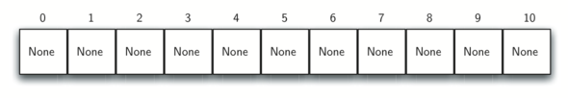
Concept of Hashing
A hash table is a collection of items which are stored in such a way as to make it easy to find them later.
Each position of the hash table, often called a slot, can hold an item and is named by an integer value starting at 0.
For example, we will have a slot named 0, a slot named 1, a slot named 2, and so on.
Initially, the hash table contains no items so every slot is empty.
We can implement a hash table by using a list with each element initialized to 0. Figure shows a hash table of size m=11. In other words, there are m slots in the table, named 0 through 10.

Slide 8
Continued…
When K is much smaller than U, a hash table requires much less space than a direct-address table
A hash table, or a hash map, is a data structure that associates keys (names) with values (attributes). For example
  Look-Up Table
  Dictionary
  Cache
  Extended Array

Slide 9
Continued…
Hash table :
  Collection of pairs,
  Lookup function (Hash function)
Hash tables are often used to implement associative arrays,
  Worst-case time for Get, Insert, and Delete is O(size).
  Expected time is O(1).

Slide 10
Hashing
Suppose we were to come up with a “magic function” that, given a value to search for, would tell us exactly where in the array to look
  If it’s in that location, it’s in the array
  If it’s not in that location, it’s not in the array
This function would have no other purpose
If we look at the function’s inputs and outputs, they probably won’t “make sense”
This function is called a hash function because it “makes hash” of its inputs

Slide 11
Continued…
Idea:
  Use a function h to compute the slot for each key
  Store the element in slot h(k)
A hash function h transforms a key into an index in a hash table T[0…m-1]:
h : U → {0, 1, . . . , m - 1}
We say that k hashes to slot h(k)
Advantages:
  Reduce the range of array indices handled: m instead of |U|
  Storage is also reduced

Slide 12
Continued…Example
0
U
(universe of keys)
h(k₁)
h(k₄)
k₁
K
(actual
keys)
k₄
k₂
h(k₂) = h(k₅)
k₅
k₃
h(k₃)
m - 1

Slide 13
Example (ideal) hash function
Suppose our hash function gave us the following values:
  hashCode("apple") = 5
  hashCode("watermelon") = 3
  hashCode("grapes") = 8
  hashCode("cantaloupe") = 7
  hashCode("kiwi") = 0
  hashCode("strawberry") = 9
  hashCode("mango") = 6
  hashCode("banana") = 2
0
1
2
3
4
5
6
7
8
9
kiwi
banana
watermelon
apple
mango
cantaloupe
grapes
strawberry

Slide 14
Why hash tables?
We don’t (usually) use hash tables just to see if something is there or not—instead, we put key/value pairs into the table
  We use a key to find a place in the table
  The value holds the information we are actually interested in
. . .
141
142
143
144
145
146
147
148
key value
robin
robin info
sparrow
sparrow info
hawk
hawk info
seagull
seagull info
bluejay
bluejay info
owl
owl info

Slide 15
Finding the hash function
How can we come up with this magic function?
In general, we cannot--there is no such magic function
  In a few specific cases, where all the possible values are known in advance, it has been possible to compute a perfect hash function
What is the next best thing?
  A perfect hash function would tell us exactly where to look
  In general, the best we can do is a function that tells us where to start looking!

Slide 16
Example imperfect hash function
Suppose our hash function gave us the following values:
  hash("apple") = 5
  hash("watermelon") = 3
  hash("grapes") = 8
  hash("cantaloupe") = 7
  hash("kiwi") = 0
  hash("strawberry") = 9
  hash("mango") = 6
  hash("banana") = 2
  hash("honeydew") = 6
0
1
2
3
4
5
6
7
8
9
kiwi
banana
watermelon
apple
mango
cantaloupe
grapes
strawberry
• Now what?

Slide 17
Collisions
When two values hash to the same array location, this is called a collision
Collisions are normally treated as “first come, first served”—the first value that hashes to the location gets it
We have to find something to do with the second and subsequent values that hash to this same location

Slide 18
Handling collisions
What can we do when two different values attempt to occupy the same place in an array?
  Solution #1: Search from there for an empty location
    Can stop searching when we find the value or an empty location
    Search must be end-around
  Solution #2: Use a second hash function
    ...and a third, and a fourth, and a fifth, ...
  Solution #3: Use the array location as the header of a linked list of values that hash to this location
All these solutions work, provided:
  We use the same technique to add things to the array as we use to search for things in the array

Slide 19
Insertion, I
Suppose you want to add seagull to this hash table
Also suppose:
  hashCode(seagull) = 143
  table[143] is not empty
  table[143] != seagull
  table[144] is not empty
  table[144] != seagull
  table[145] is empty
Therefore, put seagull at location 145
. . .
141
142
143
144
145
146
147
148
. . .
robin
sparrow
hawk
seagull
bluejay
owl

Slide 20
Searching, I
Suppose you want to look up seagull in this hash table
Also suppose:
  hashCode(seagull) = 143
  table[143] is not empty
  table[143] != seagull
  table[144] is not empty
  table[144] != seagull
  table[145] is not empty
  table[145] == seagull !
We found seagull at location 145
. . .
141
142
143
144
145
146
147
148
. . .
robin
sparrow
hawk
seagull
bluejay
owl

Slide 21
Searching, II
Suppose you want to look up cow in this hash table
Also suppose:
  hashCode(cow) = 144
  table[144] is not empty
  table[144] != cow
  table[145] is not empty
  table[145] != cow
  table[146] is empty
If cow were in the table, we should have found it by now
Therefore, it isn’t here
. . .
141
142
143
144
145
146
147
148
. . .
robin
sparrow
hawk
seagull
bluejay
owl

Slide 22
Insertion, II
Suppose you want to add hawk to this hash table
Also suppose
  hashCode(hawk) = 143
  table[143] is not empty
  table[143] != hawk
  table[144] is not empty
  table[144] == hawk
hawk is already in the table, so do nothing
. . .
141
142
143
144
145
146
147
148
. . .
robin
sparrow
hawk
seagull
bluejay
owl

Slide 23
Insertion, III
Suppose:
  You want to add cardinal to this hash table
  hashCode(cardinal) = 147
  The last location is 148
  147 and 148 are occupied
Solution:
  Treat the table as circular; after 148 comes 0
  Hence, cardinal goes in location 0 (or 1, or 2, or ...)
. . .
141
142
143
144
145
146
147
148
robin
sparrow
hawk
seagull
bluejay
owl

Slide 24
Clustering
One problem with the above technique is the tendency to form “clusters”
A cluster is a group of items not containing any open slots
The bigger a cluster gets, the more likely it is that new values will hash into the cluster, and make it ever bigger
Clusters cause efficiency to degrade
Here is a non-solution: instead of stepping one ahead, step n locations ahead
  The clusters are still there, they’re just harder to see
  Unless n and the table size are mutually prime, some table locations are never checked

Slide 25
Efficiency
Hash tables are actually surprisingly efficient
Until the table is about 70% full, the number of probes (places looked at in the table) is typically only 2 or 3
Sophisticated mathematical analysis is required to prove that the expected cost of inserting into a hash table, or looking something up in the hash table, is O(1)
Even if the table is nearly full (leading to long searches), efficiency is usually still quite high

Slide 26
Solution #2: Rehashing
In the event of a collision, another approach is to rehash: compute another hash function
  Since we may need to rehash many times, we need an easily computable sequence of functions
Simple example: in the case of hashing Strings, we might take the previous hash code and add the length of the String to it
  Probably better if the length of the string was not a component in computing the original hash function
Possibly better yet: add the length of the String plus the number of probes made so far
  Problem: are we sure we will look at every location in the array?
Rehashing is a fairly uncommon approach, and we won’t pursue it any further here

Slide 27
Solution #3: Bucket hashing
The previous solutions used open hashing: all entries went into a “flat” (unstructured) array
Another solution is to make each array location the header of a linked list of values that hash to that location
. . .
141
142
143
144
145
146
147
148
. . .
robin
sparrow
seagull
hawk
bluejay
owl

Slide 28
Collisions
Two or more keys hash to the same slot!!
For a given set K of keys
  If |K| ≤ m, collisions may or may not happen, depending on the hash function
  If |K| > m, collisions will definitely happen (i.e., there must be at least two keys that have the same hash value)
Avoiding collisions completely is hard, even with a good hash function

Slide 29
Handling Collisions
We will review the following methods:
  Chaining
  Open addressing
    Linear probing
    Quadratic probing
    Double hashing
We will discuss chaining first, and ways to build “good” functions.

Slide 30
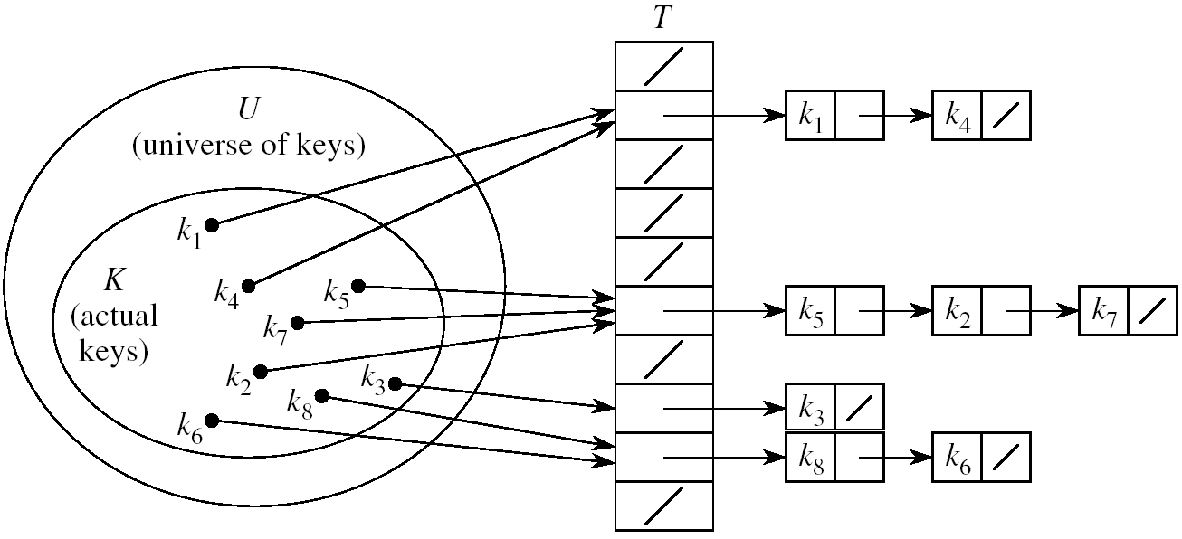
Handling Collisions Using Chaining
Idea:
  Put all elements that hash to the same slot into a linked list
  Slot j contains a pointer to the head of the list of all elements that hash to j

Slide 31
Collision with Chaining - Discussion
Choosing the size of the table
  Small enough not to waste space
  Large enough such that lists remain short
  Typically 1/5 or 1/10 of the total number of elements
How should we keep the lists: ordered or not?
  Not ordered!
    Insert is fast
    Can easily remove the most recently inserted elements

Slide 32
Insertion in Hash Tables
Alg.: CHAINED-HASH-INSERT(T, x)
insert x at the head of list T[h(key[x])]
Worst-case running time is O(1)
Assumes that the element being inserted isn’t already in the list
It would take an additional search to check if it was already inserted

Slide 33
Deletion in Hash Tables
Alg.: CHAINED-HASH-DELETE(T, x)
delete x from the list T[h(key[x])]
Need to find the element to be deleted.
Worst-case running time:
  Deletion depends on searching the corresponding list

Slide 34
Searching in Hash Tables
Alg.: CHAINED-HASH-SEARCH(T, k)
search for an element with key k in list T[h(k)]
Running time is proportional to the length of the list of elements in slot h(k)

Slide 35
Analysis of Hashing with Chaining:
Worst Case
How long does it take to search for an element with a given key?
Worst case:
  All n keys hash to the same slot
  Worst-case time to search is Θ(n), plus time to compute the hash function
T
0
chain
m - 1

Slide 36
Analysis of Hashing with Chaining:
Average Case
Average case
  depends on how well the hash function distributes the n keys among the m slots
Simple uniform hashing assumption:
  Any given element is equally likely to hash into any of the m slots (i.e., probability of collision Pr(h(x)=h(y)), is 1/m)
Length of a list:
T[j] = n_{j}, j = 0, 1, . . . , m – 1
Number of keys in the table:
n = n₀ + n₁ +· · · + n_{m-1}
Average value of n_{j}:
E[n_{j}] = α = n/m
T
n₀ = 0
n₂
n₃
n_{j}
n_{k}
n_{m – 1} = 0

Slide 37
Load Factor of a Hash Table
Load factor of a hash table T:
α = n/m
  n = # of elements stored in the table
  m = # of slots in the table = # of linked lists
α encodes the average number of elements stored in a chain
α can be <, =, > 1
T
0
chain
chain
chain
chain
m - 1

Slide 38
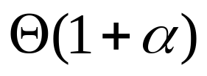
Case 1: Unsuccessful Search
(i.e., item not stored in the table)
Theorem
An unsuccessful search in a hash table takes expected time under the assumption of simple uniform hashing
(i.e., probability of collision Pr(h(x)=h(y)), is 1/m)
Proof
Searching unsuccessfully for any key k
  need to search to the end of the list T[h(k)]
Expected length of the list:
  E[n_{h(k)}] = α = n/m
Expected number of elements examined in an unsuccessful search is α
Total time required is:
  O(1) (for computing the hash function) + α →

Slide 39
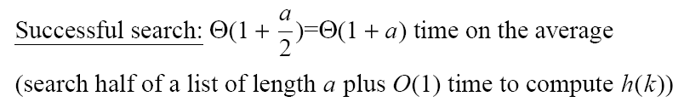
Case 2: Successful Search

Slide 40
Analysis of Search in Hash Tables
If m (# of slots) is proportional to n (# of elements in the table):
n = O(m)
α = n/m = O(m)/m = O(1)
⇒ Searching takes constant time on average

Slide 41
Hash Functions
A hash function transforms a key into a table address
What makes a good hash function?
  (1) Easy to compute
  (2) Approximates a random function: for every input, every output is equally likely (simple uniform hashing)
In practice, it is very hard to satisfy the simple uniform hashing property
  i.e., we don’t know in advance the probability distribution that keys are drawn from

Slide 42
Good Approaches for Hash Functions
Minimize the chance that closely related keys hash to the same slot
  Strings such as pt and pts should hash to different slots
Derive a hash value that is independent from any patterns that may exist in the distribution of the keys

Slide 43
The Division Method
Idea:
  Map a key k into one of the m slots by taking the remainder of k divided by m
  h(k) = k mod m
Advantage:
  fast, requires only one operation
Disadvantage:
  Certain values of m are bad, e.g.,
    power of 2
    non-prime numbers

Slide 44
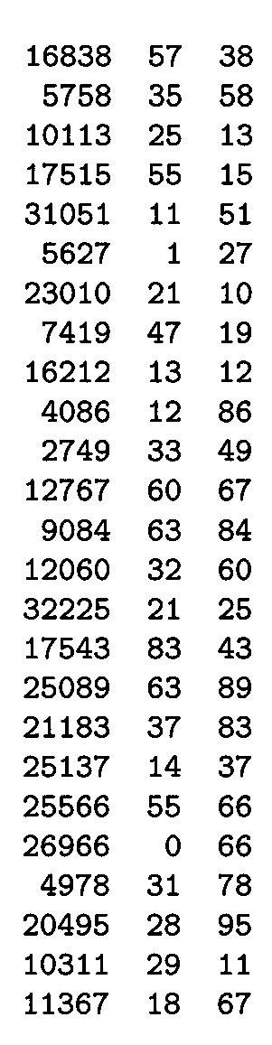
Example - The Division Method
m97
m
100
If m = 2^{p}, then h(k) is just the least significant p bits of k
  p = 1 ⇒ m = 2
  ⇒ h(k) = , least significant 1 bit of k
  p = 2 ⇒ m = 4
  ⇒ h(k) = , least significant 2 bits of k
Choose m to be a prime, not close to a
power of 2
  Column 2:
  Column 3:
{0, 1}
{0, 1, 2, 3}
k mod 97
k mod 100

Slide 45

The Multiplication Method
Idea:
Multiply key k by a constant A, where 0 < A < 1
Extract the fractional part of kA
Multiply the fractional part by m
Take the floor of the result
h(k) = = ⎣m (k A mod 1)⎦
Disadvantage: Slower than division method
Advantage: Value of m is not critical, e.g., typically 2^{p}
fractional part of kA = kA - ⎣kA⎦

Slide 46
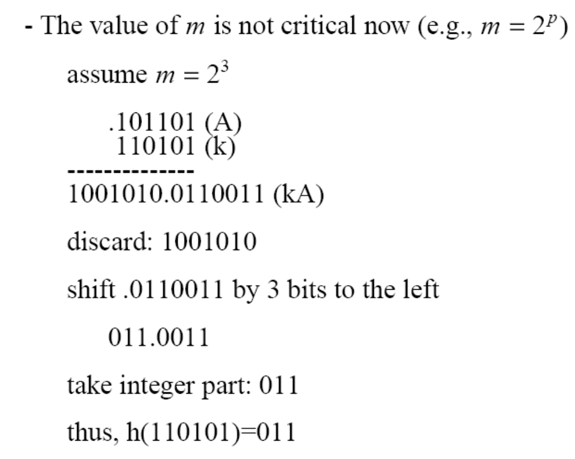
Example – Multiplication Method

Slide 47
Universal Hashing
In practice, keys are not randomly distributed
Any fixed hash function might yield Θ(n) time
Goal: hash functions that produce random table indices irrespective of the keys
Idea:
  Select a hash function at random, from a designed class of functions at the beginning of the execution
Notes:
Θ(n) means tight bound. Ω(n) represents lower bound. f(x) = Θ(g(x)) iff f(x) = O(g(x)) and f(x) = Ω(g(x)) Basically when we say an algorithm is of O(n), it's also O(n²), O(n¹⁰⁰⁰⁰⁰⁰), O(2^{n}), ... but a Θ(n) algorithm is not Θ(n²)

Slide 48
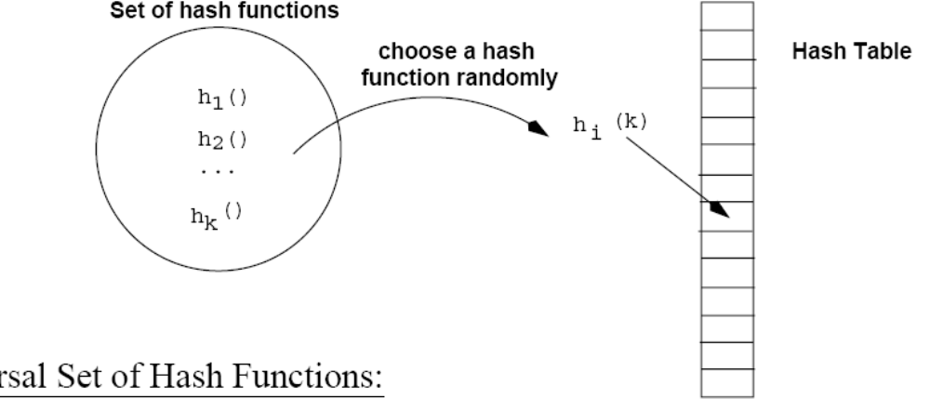
Universal Hashing
(at the beginning
of the execution)

Slide 49
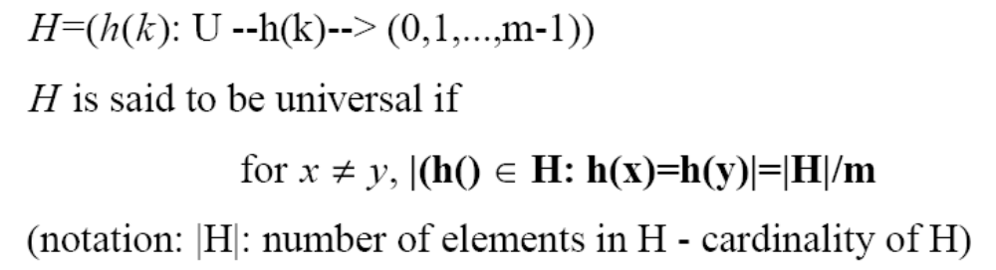
Definition of Universal Hash Functions
H={h(k): U→(0,1,..,m-1)}

Slide 50
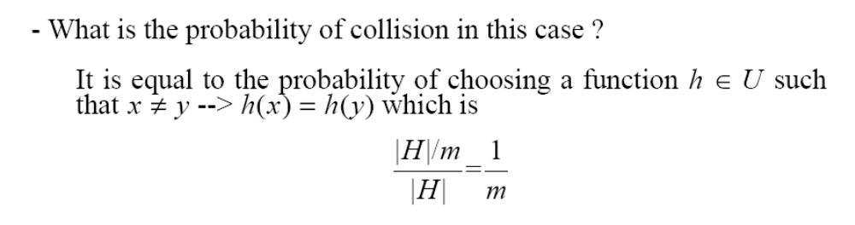
How is this property useful?
Pr(h(x)=h(y))=

Slide 51
Universal Hashing – Main Result
With universal hashing the chance of collision between distinct keys k and l is no more than the 1/m chance of collision if locations h(k) and h(l) were randomly and independently chosen from the set {0, 1, …, m – 1}

Slide 52
Designing a Universal Class of Hash Functions
Choose a prime number p large enough so that every possible key k is in the range [0 ... p – 1]
Z_{p} = {0, 1, …, p - 1} and Z_{p}* = {1, …, p - 1}
Define the following hash function
h_{a,b}(k) = ((ak + b) mod p) mod m,
∀ a ∈ Z_{p}* and b ∈ Z_{p}
The family of all such hash functions is
H_{p,m} = {h_{a,b}: a ∈ Z_{p}* and b ∈ Z_{p}}
a , b: chosen randomly at the beginning of execution
The class H_{p,m} of hash
functions is universal

Slide 53
Example: Universal Hash Functions
E.g.: p = 17, m = 6
h_{a,b}(k) = ((ak + b) mod p) mod m
h_{3,4}(8) = ((3⋅8 + 4) mod 17) mod 6
= (28 mod 17) mod 6
= 11 mod 6
= 5

Slide 54
Advantages of Universal Hashing
Universal hashing provides good results on average, independently of the keys to be stored
Guarantees that no input will always elicit the worst-case behavior
Poor performance occurs only when the random choice returns an inefficient hash function – this has small probability

Slide 55
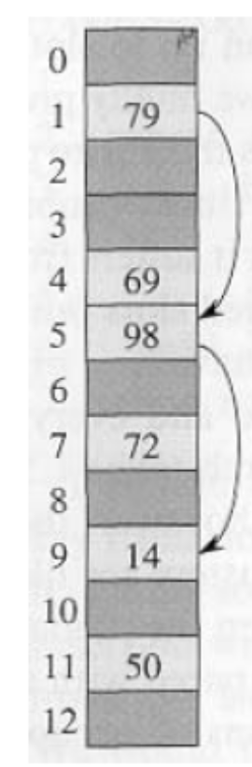
Open Addressing
If we have enough contiguous memory to store all the keys (m > N) ⇒ store the keys in the table itself
No need to use linked lists anymore
Basic idea:
  Insertion: if a slot is full, try another one,
  until you find an empty one
  Search: follow the same sequence of probes
  Deletion: more difficult ... (we’ll see why)
Search time depends on the length of the
probe sequence!
e.g., insert 14

Slide 56
Generalize hash function notation:
A hash function contains two arguments now:
  (i) Key value, and (ii) Probe number
  h(k,p), p=0,1,...,m-1
Probe sequences
<h(k,0), h(k,1), ..., h(k,m-1)>
  Must be a permutation of <0,1,...,m-1>
  There are m! possible permutations
  Good hash functions should be able to
  produce all m! probe sequences
insert 14
Example
<1, 5, 9>

Slide 57
Common Open Addressing Methods
Linear probing
Quadratic probing
Double hashing
Note: None of these methods can generate more than m² different probing sequences!

Slide 58
Linear probing: Inserting a key
Idea: when there is a collision, check the next available position in the table (i.e., probing)
h(k,i) = (h₁(k) + i) mod m
i=0,1,2,...
First slot probed: h₁(k)
Second slot probed: h₁(k) + 1
Third slot probed: h₁(k)+2, and so on
Can generate m probe sequences maximum, why?
probe sequence: < h1(k), h1(k)+1 , h1(k)+2 , ....>
wrap around

Slide 59
Linear probing: Searching for a key
Three cases:
  (1) Position in table is occupied with an element of equal key
  (2) Position in table is empty
  (3) Position in table occupied with a different element
Case 2: probe the next higher index until the element is found or an empty position is found
The process wraps around to the beginning of the table
0
h(k₁)
h(k₄)
h(k₂) = h(k₅)
h(k₃)
m - 1

Slide 60
Linear probing: Deleting a key
Problems
  Cannot mark the slot as empty
  Impossible to retrieve keys inserted after that slot was occupied
Solution
  Mark the slot with a sentinel value DELETED
The deleted slot can later be used for insertion
Searching will be able to find all the keys
0
m - 1

Slide 61
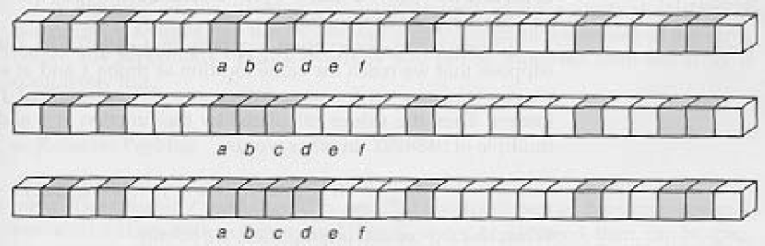
Primary Clustering Problem
Some slots become more likely than others
Long chunks of occupied slots are created
⇒ search time increases!!
initially, all slots have probability 1/m
Slot b:
2/m
Slot d:
4/m
Slot e:
5/m

Slide 62
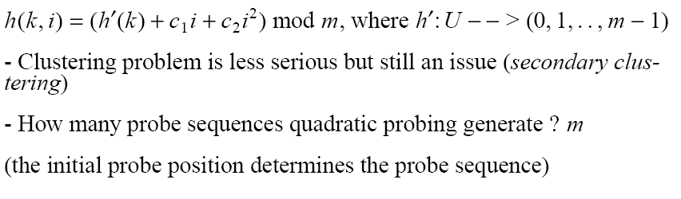
Quadratic probing
i=0,1,2,...

Slide 63
Double Hashing
(1) Use one hash function to determine the first slot
(2) Use a second hash function to determine the increment for the probe sequence
h(k,i) = (h₁(k) + i h₂(k) ) mod m, i=0,1,...
Initial probe: h₁(k)
Second probe is offset by h₂(k) mod m, so on ...
Advantage: avoids clustering
Disadvantage: harder to delete an element
Can generate m² probe sequences maximum

Slide 64
Double Hashing: Example
h₁(k) = k mod 13
h₂(k) = 1+ (k mod 11)
h(k,i) = (h₁(k) + i h₂(k) ) mod 13
Insert key 14:
h₁(14,0) = 14 mod 13 = 1
h(14,1) = (h₁(14) + h₂(14)) mod 13
= (1 + 4) mod 13 = 5
h(14,2) = (h₁(14) + 2 h₂(14)) mod 13
= (1 + 8) mod 13 = 9
0
79
69
98
72
50
1
2
3
4
5
6
7
8
9
14
10
11
12

Slide 65
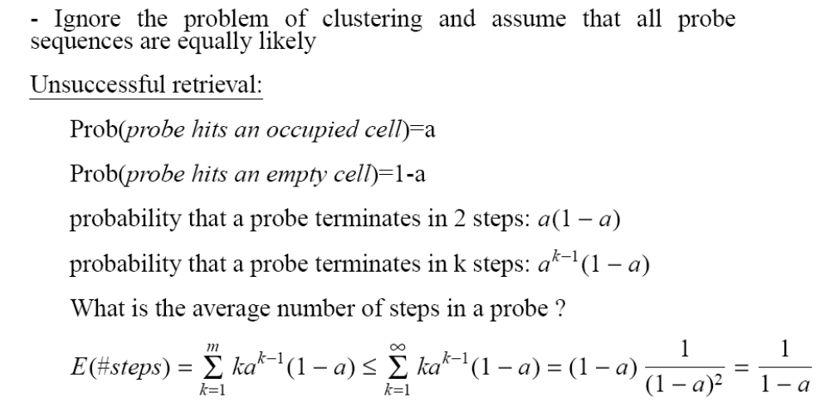

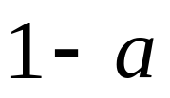
Analysis of Open Addressing
(load factor)
k=0

Slide 66
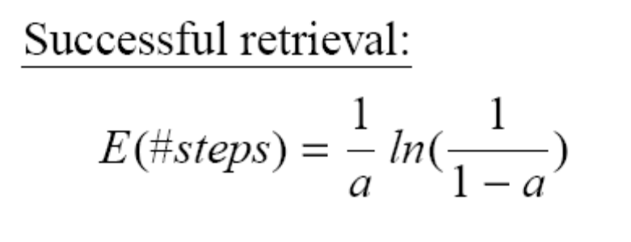
Analysis of Open Addressing (cont’d)
Unsuccessful retrieval:
a=0.5 E(#steps) = 2
a=0.9 E(#steps) = 10
Successful retrieval:
a=0.5 E(#steps) = 3.387
a=0.9 E(#steps) = 3.670

Slide 67
Search vs. Hashing
Search tree methods: key comparisons
  Time complexity: O(size) or O(log n)
Hashing methods: hash functions
  Expected time: O(1)
Types
  Static hashing
  Dynamic hashing

Slide 68
Revisited: Hash functions
A hash function that maps each item into a unique slot is referred to as a perfect hash function.
If we know the items and the collection will never change, then it is possible to construct a perfect hash function.
Unfortunately, given an arbitrary collection of items, there is no systematic way to construct a perfect hash function. Luckily, we do not need the hash function to be perfect to still gain performance efficiency.
One way to always have a perfect hash function is to increase the size of the hash table so that each possible value in the item range can be accommodated.
This guarantees that each item will have a unique slot. Although this is practical for small numbers of items, it is not feasible when the number of possible items is large.
For example, if the items were nine-digit Social Security numbers, this method would require almost one billion slots.
If we only want to store data for a class of 25 students, we will be wasting an enormous amount of memory.

Slide 69
Continued…
Goal is to create a hash function that minimizes the number of collisions, is easy to compute, and evenly distributes the items in the hash table. There are a number of common ways to extend the simple remainder method. We will consider a few of them here.
The folding method for constructing hash functions begins by dividing the item into equal-size pieces (the last piece may not be of equal size). These pieces are then added together to give the resulting hash value.
For example, if item is the phone number 436-555-4601, we would take the digits and divide them into groups of 2 (43,65,55,46,01). After the addition, 43+65+55+46+01, we get 210.
If we assume hash table has 11 slots, then we need to perform the extra step of dividing by 11 and keeping the remainder. In this case 210 % 11 is 1, so the phone number 436-555-4601 hashes to slot 1.
Some folding methods go one step further and reverse every other piece before the addition. For the above example, we get 43+56+55+64+01=219 which gives 219 % 11=10.

Slide 70
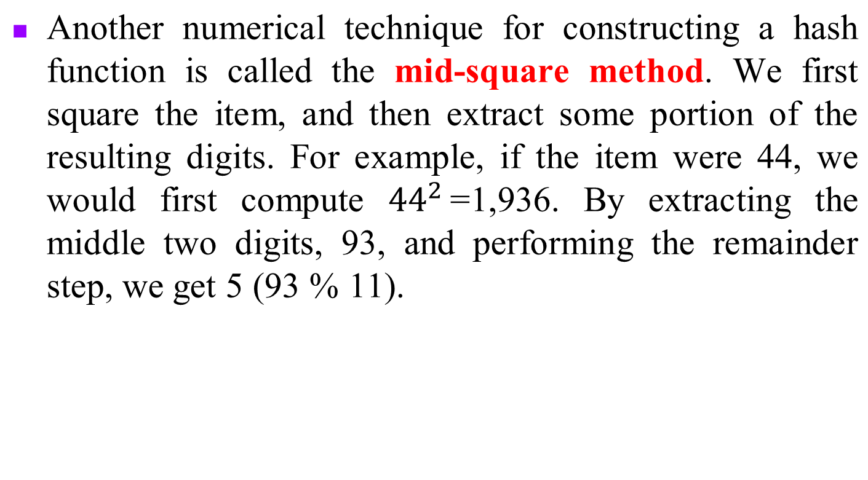
Continued…

Slide 71
Continued…
Item | Remainder | Mid-Square
54 | 10 | 3
26 | 4 | 7
93 | 5 | 9
17 | 6 | 8
77 | 0 | 4
31 | 9 | 6
Table shows items under both the remainder method and the mid-square method. You should verify that you understand how these values were computed

Slide 72
Continued…Strings
We can also create hash functions for character-based items such as strings. The word “cat” can be thought of as a sequence of ordinal values.
  ordinal('c'): 99
  ordinal('a'): 97
  ordinal('t'): 116
We can then take these three ordinal values, add them up, and use the remainder method to get a hash value

Slide 73
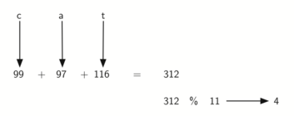
Continued…
Hashing a String Using Ordinal Values. A function called hash that takes a string and a table size and returns the hash value in the range from 0 to tablesize-1.
def hash(astring, tablesize):
sum = 0
for pos in range(len(astring)):
sum = sum + ord(astring[pos])
return sum%tablesize

Slide 74
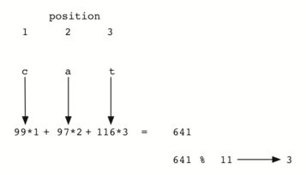
Continued…
It is interesting to note that when using this hash function, anagrams will always be given the same hash value. To remedy this, we could use the position of the character as a weight. Figure shows one possible way to use the positional value as a weighting factor. The modification to the hash function is left as an exercise.

Slide 75
Static Hashing
Key-value pairs are stored in a fixed size table called a hash table.
  A hash table is partitioned into many buckets.
  Each bucket has many slots.
  Each slot holds one record.
  A hash function f(x) transforms the identifier (key) into an address in the hash table

Slide 76
Hash table
s slots
0
1
s-1
 |  | . . .
. . . | . . . |  | . . .
 |  | . . .
0
1
b buckets
b-1

Slide 77
Data Structure for Hash Table
#define MAX_CHAR 10
#define TABLE_SIZE 13
typedef struct {
char key[MAX_CHAR];
/* other fields */
} element;
element hash_table[TABLE_SIZE];

